Slide 1
Technical Support (420-1N6-AB) More detail on Logic Circuits
Fall 2023
Adapted for Fall 2024

Slide 2
Half, Full, and Multibit Adder circuits

Slide 3
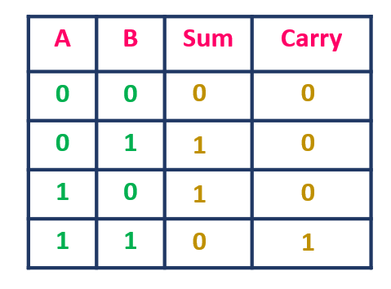
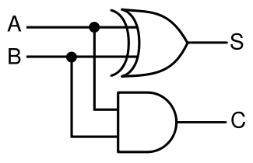
Half Adder
Review: we can add two bits using a combo of an XOR and an AND gate

Slide 4
Half Adder
Why do we call it a half adder?
It can only add 1 bit to another -- we cannot get numbers like 100₂ (4₁₀) .
We cannot simply combine two half adders -- need to be able to track if there is any CARRY from previous addition
need another input here

Slide 5
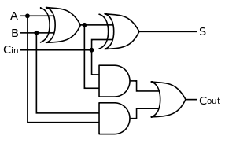
Full Adder
A | B | Cin | Cout | S
0 | 0 | 0 | 0 | 0
0 | 0 | 1
You complete this truth table in lab 5

Slide 6
Full Adder: structure
Full adder:
2 half adders,
combine with OR
If there is CARRY from the sum of inputs,
OR if there is carry from previous addition
then Cout = 1

Slide 7
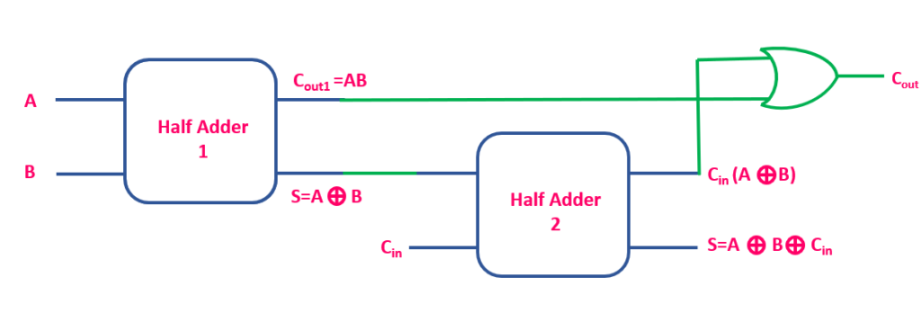
Full Adder: structure
Another way to draw the same thing:
See https://www.allaboutelectronics.org/half-adder-and-full-adder-explained/ for a great explanation

Slide 8
Creating Logic Circuits:
Sum of Products + Product of Sums techniques

Slide 9
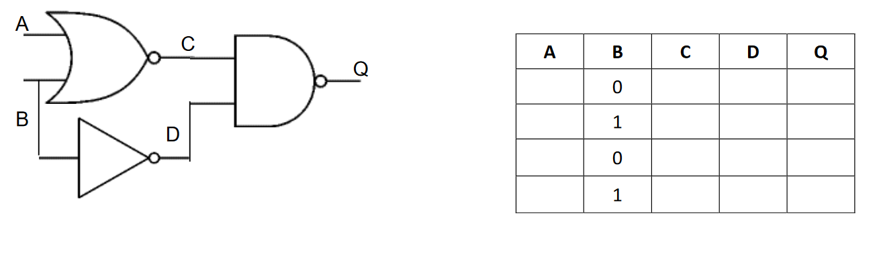
Creating a truth table from a logic circuit
To create the truth table for a logic circuit:
Try all combinations of inputs
Compute the result for each gate one by one
Repeat until end of gate reached

Slide 10
Creating a truth table from a logic circuit
To create the truth table for a logic circuit:
Try all combinations of inputs
Compute the result for each gate one by one
Repeat until end of gate reached
A | B | C | D | Q
0 | 0
0 | 1
1 | 0
1 | 1

Slide 11
Creating a truth table from a logic circuit
To create the truth table for a logic circuit:
Try all combinations of inputs
Compute the result for each gate one by one
Repeat until end of gate reached
A | B | C | D | Q
0 | 0 | not(A OR B) | not(B) | NAND(C,D)
0 | 1 | not(A OR B) | not(B) | NAND(C,D)
1 | 0 | not(A OR B) | not(B) | NAND(C,D)
1 | 1 | not(A OR B) | not(B) | NAND(C,D)

Slide 12
Creating a truth table from a logic circuit
To create the truth table for a logic circuit:
Try all combinations of inputs
Compute the result for each gate one by one
Repeat until end of gate reached
A | B | C | D | Q
0 | 0 | not(0) | 1 | NAND(C,D)
0 | 1 | not(1) | 0 | NAND(C,D)
1 | 0 | not(1) | 1 | NAND(C,D)
1 | 1 | not(1) | 0 | NAND(C,D)

Slide 13
Creating a truth table from a logic circuit
To create the truth table for a logic circuit:
Try all combinations of inputs
Compute the result for each gate one by one
Repeat until end of gate reached
A | B | C | D | Q
0 | 0 | 1 | 1 | NAND(C,D)
0 | 1 | 0 | 0 | NAND(C,D)
1 | 0 | 0 | 1 | NAND(C,D)
1 | 1 | 0 | 0 | NAND(C,D)

Slide 14
Creating a truth table from a logic circuit
To create the truth table for a logic circuit:
Try all combinations of inputs
Compute the result for each gate one by one
Repeat until end of gate reached
A | B | C | D | Q
0 | 0 | 1 | 1 | 0
0 | 1 | 0 | 0 | 1
1 | 0 | 0 | 1 | 1
1 | 1 | 0 | 0 | 1

Slide 15
(2) Logic circuit from truth table (Sum of Products)
On whiteboard -- will be added after class (Thursday Oct 10)

Slide 16
(3) Logic circuit from truth table (Sum of Products)
On whiteboard -- will be added after class (Thursday Oct 10)

